Slide 1

University of Toronto B
Robert Li
Zoey Song
Daniel Leal
Steve Kim

Slide 2
Introduction
Goal: To develop an algorithm that automatically makes optimal trades in the stock market to maximize profits
First Approach: Simulated human intuition through graphical observations and modifying parameters
Second Approach:

Slide 3
First Approach
Initially plotted historical data
Simulated human intuition
Considered multiple parameters
Implemented scoring function to heuristically decide to buy or sell a stock
Modified parameters based on performance of algorithm in each iteration

Slide 4
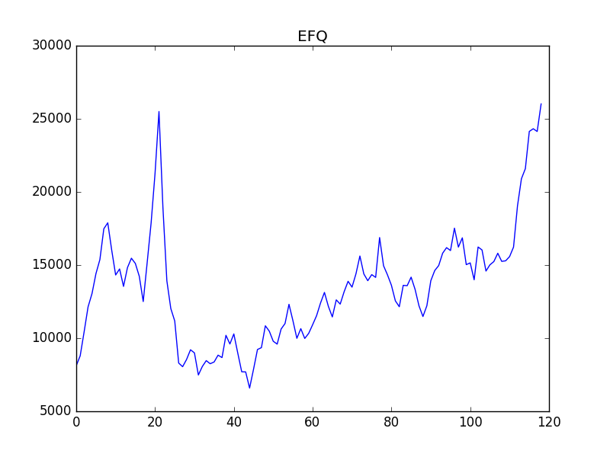
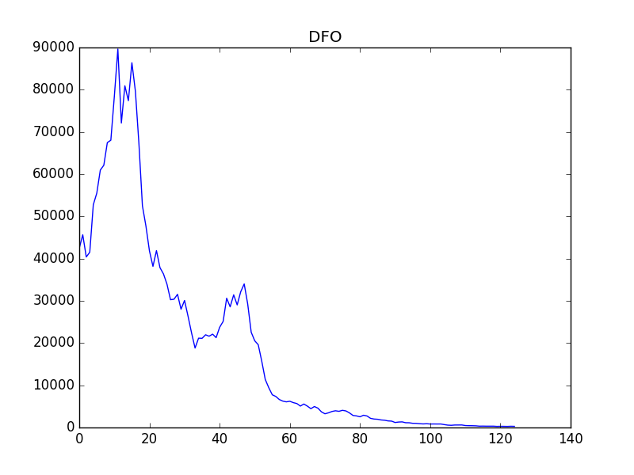
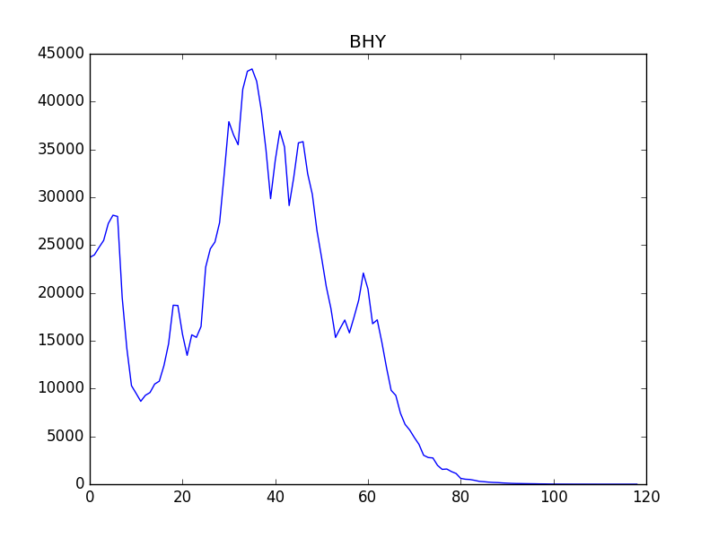
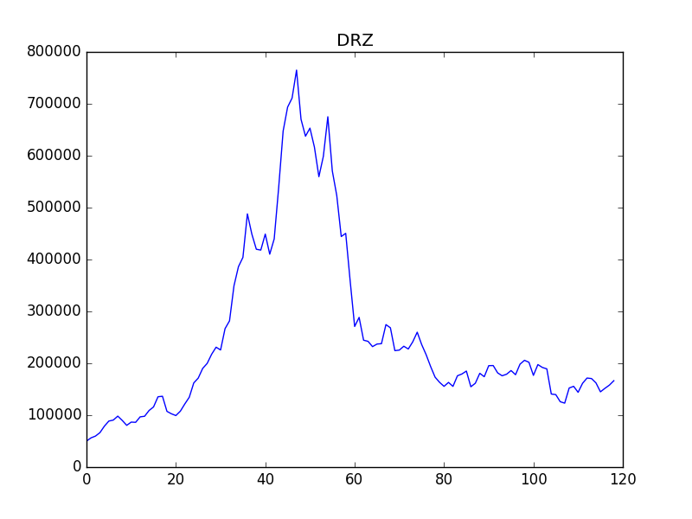
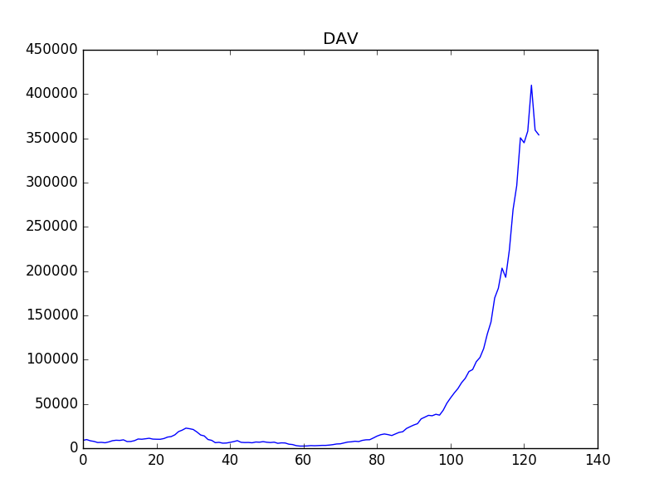
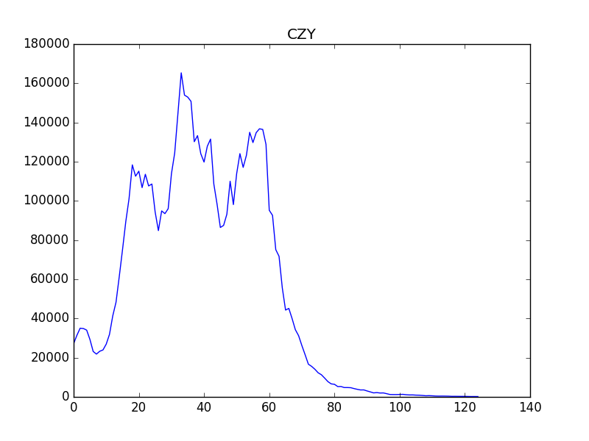

Slide 5
Second Approach
Using polynomial fit
Gradient descent
Modifying the order of polynomial used to fit

Slide 6
Conclusion
Checked input is valid
Minimized number of requests
Optimized data storage

Slide 7
Thank you.

